Slide 1


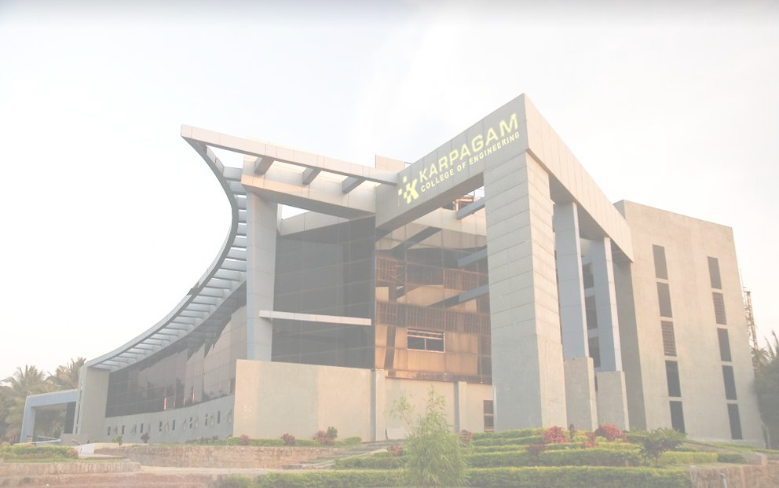

Fingerprint Voting System
By
Mohammed Adel Rahman N 717822P232
Poothesh M 717822P239
Kavin Kumar K M 717822P225
Muthukrishnan S 717822P234
Supervisior
Dr.S. Arul Antran Vijay, ASP/CSE
Computer Science and Engineering .

Slide 2
INTRODUCTION
A Fingerprint Voting System is a biometric-based voting method that uses fingerprints for voter authentication. It ensures that only eligible voters can cast their vote, preventing fraud and duplication. This system offers a more secure and reliable approach to the electoral process.
Importance :
Prevents voter fraud by ensuring only registered voters can vote.
Improves election security by using unique biometric data for authentication.
Streamlines the voting process with quick and accurate voter verification, reducing errors.

Slide 3
Problem Statement
.
Technical Infrastructure:
India’s vast and diverse population requires significant technological investment in biometric scanners, reliable internet, and secure databases, especially in remote or underdeveloped regions.
Data Privacy Concerns:
Collecting and storing biometric data like fingerprints raises concerns about data misuse, privacy violations, and potential hacking risks.
Inclusion Issues:
Not everyone may have clear fingerprints due to age, manual labor, or health conditions, which could lead to disenfranchisement if alternative methods are not available.
Cost of Implementation:
Setting up the required technology and ensuring secure maintenance of the system across a large and diverse country like India can be expensive and logistically complex

Slide 4
Objective
1.Enhance Voter Authentication:
To ensure secure, accurate, and unique voter identification using biometric fingerprint technology, preventing identity fraud and multiple voting.
2.Improve Election Transparency:
To increase the transparency and integrity of the voting process by reducing manual errors and electoral malpractices.
3.Streamline the Voting Process:
To simplify and expedite the voting process through quick and efficient biometric verification, minimizing long queues and wait times at polling stations.
4.Promote Inclusive and Secure Elections:
To ensure fair access to elections for all eligible voters while maintaining the security and confidentiality of voter data.

Slide 5
LITERATURE REVIEW
Relevant Research
Article 1: Overview of Biometric Voting Systems.
Article 2: Global Adoption of Fingerprint Voting Systems.
Article 3: Fingerprint Technology: Advantages and Accuracy.
Article 4: Challenges in Rural and Low-Resource Settings.
Article 5: Data Security and Privacy Concerns.
Article 6: Inclusion and Accessibility Issues.
Article 7: Cost-Benefit Analysis of Biometric Voting.
Article 8: Legal and Ethical Considerations.
Article 9: Success Stories and Lessons from Other Democracies.
Article 10: Future Prospects and Technological Advancements.

Slide 6
Methodology
Step 1 : Biometric Data Registration - Collect voter information and fingerprint data for secure storage in the central database.
Step 2 : Voter Verification at Polling - Voter’s fingerprint is scanned at polling stations to match with stored biometric data.
Step 3 : Authentication - The system confirms the voter’s identity using real-time fingerprint verification.
Step 4 : Vote Casting - Once authenticated, the voter is allowed to cast their vote, recorded securely.
Step 5 : Data Security & Auditing - Ensure encrypted storage and auditing of votes to protect data integrity and confidentiality.

Slide 7
Work Plan
Work Plan for the Project
Phase 1: Planning and Requirement Analysis (Weeks 1-2)
Phase 2: System Design and Development (Weeks 3-5)
Phase 3: Pilot Testing and Validation (Weeks 6-8)
Phase 4: Voter Registration and Training (Weeks 9-10)
Phase 5: Full-Scale Implementation and Monitoring (Weeks 11-12)

Slide 8
Thank you

